Slide 1
Virtual Meeting Protocol
Our meeting will start shortly
Due the potential large number of participants please
mute your mic
switch off your video
do not record this meeting
Depending on time there will be an opportunity for questions at the end
avoid sharing personal pupil /parent information
do not share this meeting link with anyone other than Alford Academy parents/carers
“ Working together to nurture, inspire and achieve “
Notes:
Introduce yourself
Housekeeping – mention recording. Recording will be stopped for questions if time

Slide 2
Parent Prelim Prep
Supporting our Young People with their Studying

Slide 3
Content
Top Tips
Six Strategies of Effective Learning
Main Resources
Achieve and E-sgoil
Exam Mindset Guide
Subject Specific Resources

Slide 4
Top Tips
Chat to them and make a plan – what do they think?
Good place to work
Phones – apps like Flora Green Focus https://flora.appfinca.com/en/
Good routines
Distinction between where you work and where you relax
Time off is important – discuss what this looks like
Family relationships are important – maintain these as best you can. Remember they are stressed and this is new
Nice stationary helps but…

Slide 5
Here comes the Science bit – concentrate!
Notes:
They are cognitive psychological scientists interested in research on education. Their main research focus is on the science of learning. (Hence, "The Learning Scientists"!)
They aim to :
Motivate students to study
Increase the use of effective study and teaching strategies that are backed by research
Decrease negative views of testing

Slide 6
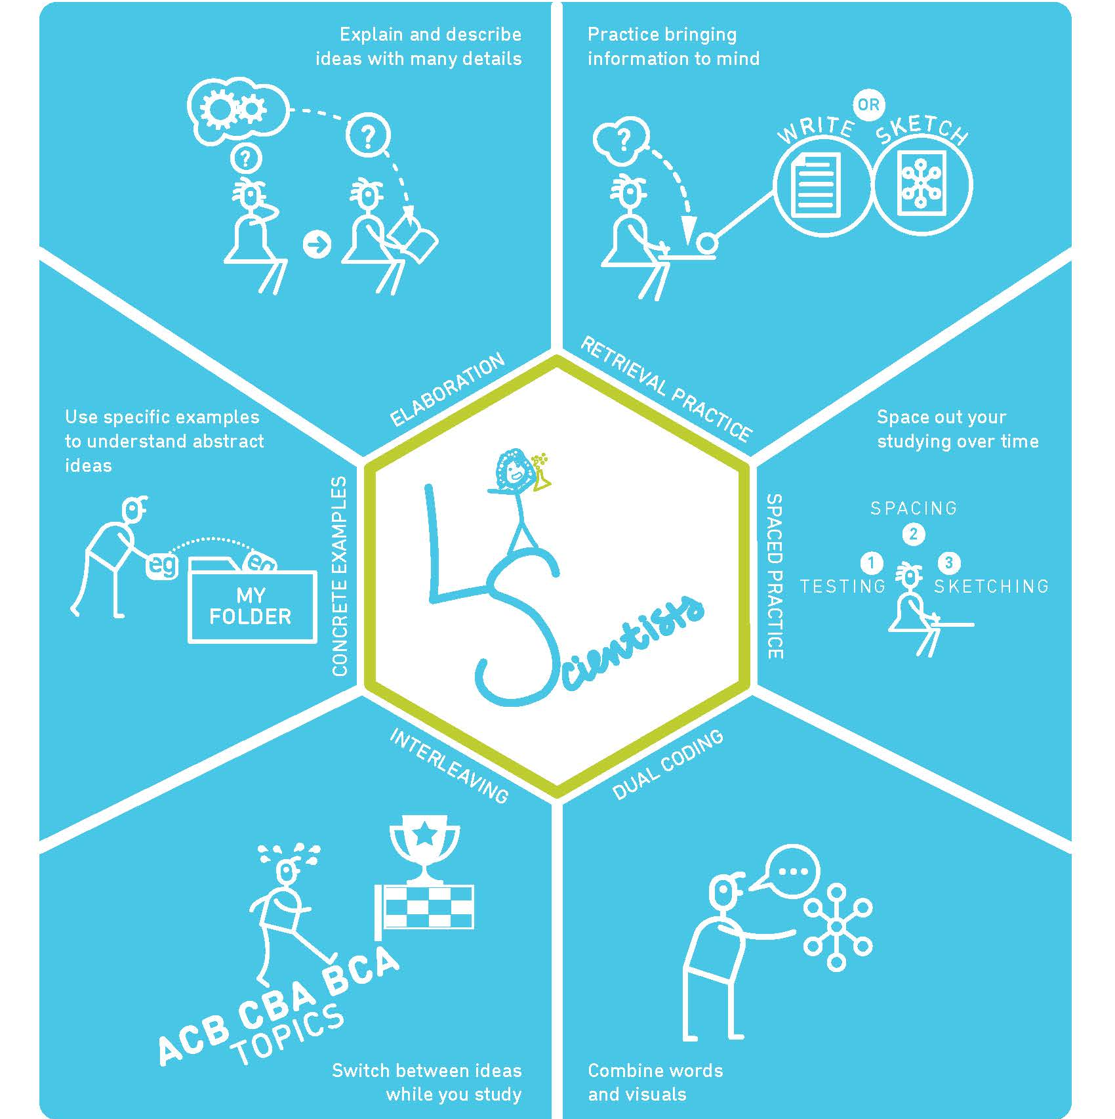
Six Strategies of Effective Learning
Notes:
Even though your child is at their desk – it unfortunately doesn’t mean they are learning.
They need to be active and they need to be focussing on improvement.
Short effective stints is better than hours of reading notes, answering questions is better than highlighting.

Slide 7
Alford Academy Resources

Slide 8
Assessment Overview
Important resources
Your National Qualifications booklet – pupils received this at an assembly
Exam timetable 2024 – start planning now
Past Papers
https://alfordacademy.edublogs.org/assessment-overview-23-24/
Understanding Standards

Slide 9
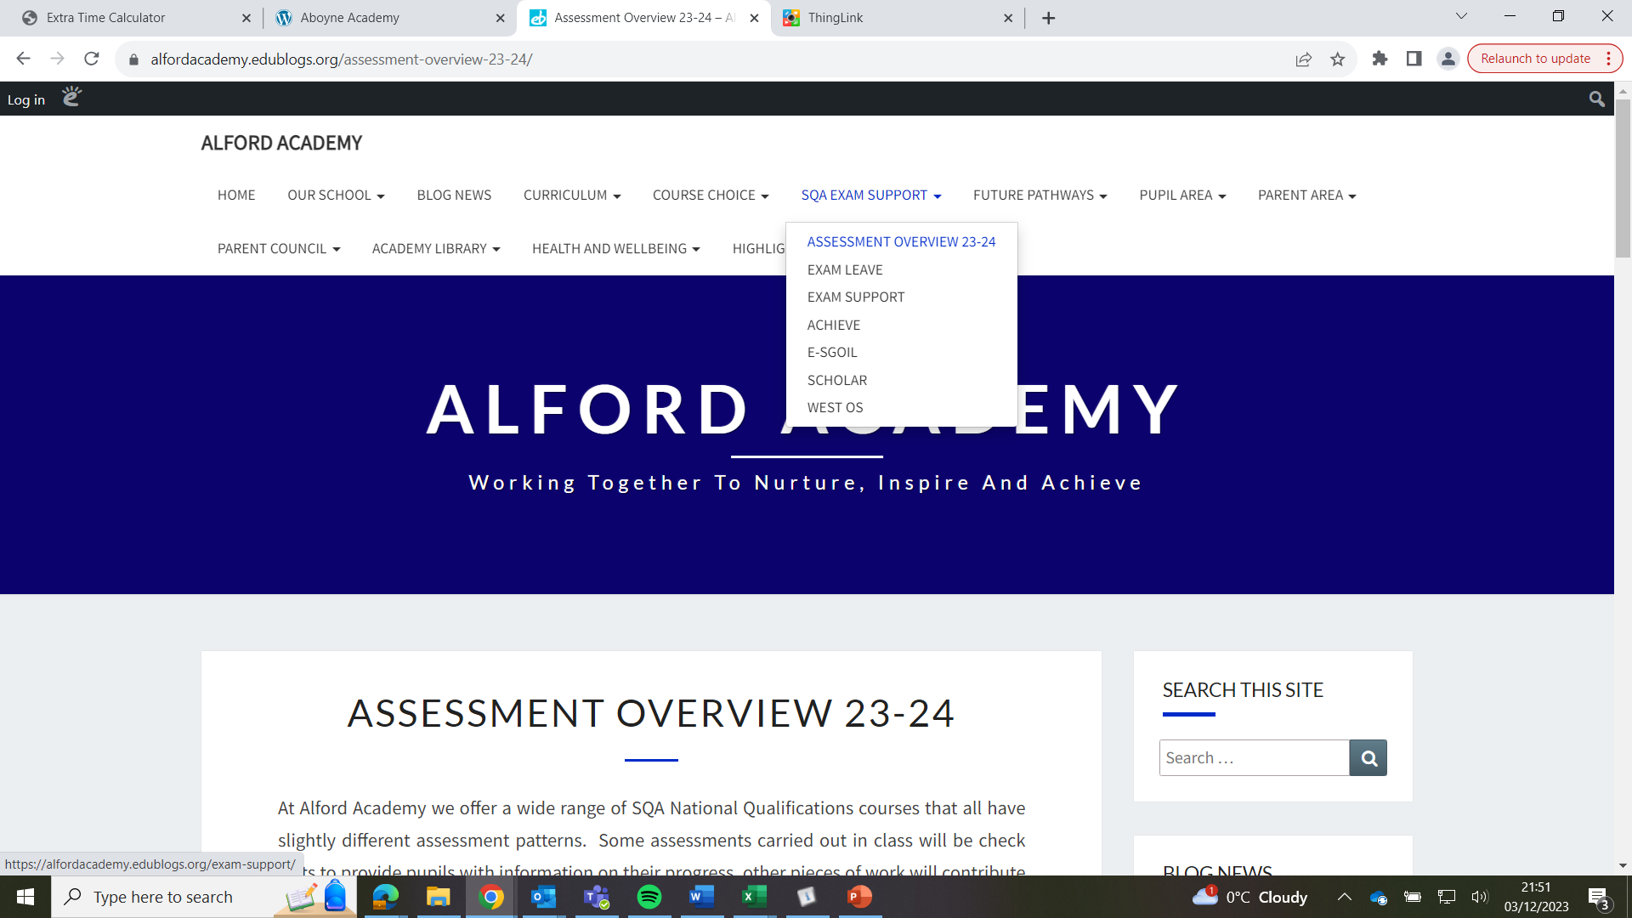
Alford Academy Main Resources
Exam Support
Achieve
E-sgoil
Scholar
West-OS
Notes:
At Alford Academy

Slide 10
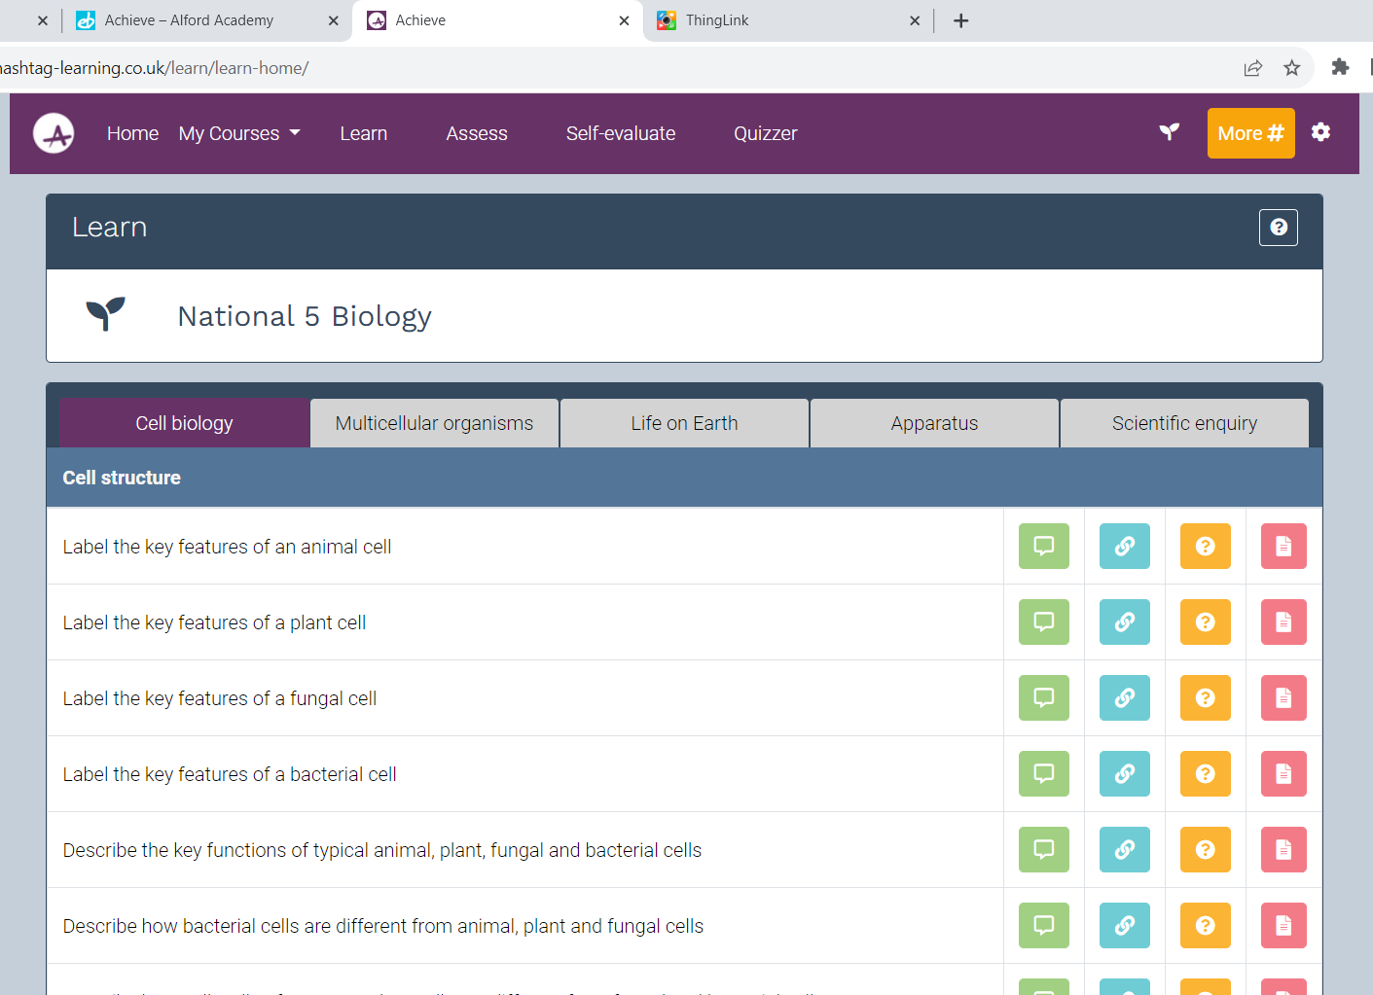
Achieve
Learn
Assess
Self-evaluate
Notes:
Learn: Using Learn – ACHIEVE (letsachieve.co.uk)
This breaks down the course to individual concepts, each of which comes with a concise explanation or example of the concept, links to further learning, extended questions and activities and links to past paper questions related to that concept.
Assess: Using Assess – ACHIEVE (letsachieve.co.uk)
ACHIEVE has a built-in assessment engine with thousands of practice questions linked to each concept. Pupils can opt to make their own assessment on a Unit or Topic of their choosing, with instant feedback given on completion. Teaching staff may also choose to create and administer assessments for whole classes.
Self-Evaluate: Using Self-evaluate – ACHIEVE (letsachieve.co.uk)
Pupils can record their confidence against each concept in a course in order to build up an overview of strengths and weaknesses by Unit and by Topics. Class teachers can access this info for individual pupils and whole classes and use it as a tool to help identify areas where additional support or teaching may be required.

Slide 11
Achieve
Learn
Explanation
Useful links
Questions and activities
Past Paper questions

Slide 12
Achieve - Assess
Notes:
Assess: Using Assess – ACHIEVE (letsachieve.co.uk)
ACHIEVE has a built-in assessment engine with thousands of practice questions linked to each concept. Pupils can opt to make their own assessment on a Unit or Topic of their choosing, with instant feedback given on completion. Teaching staff may also choose to create and administer assessments for whole classes.

Slide 13
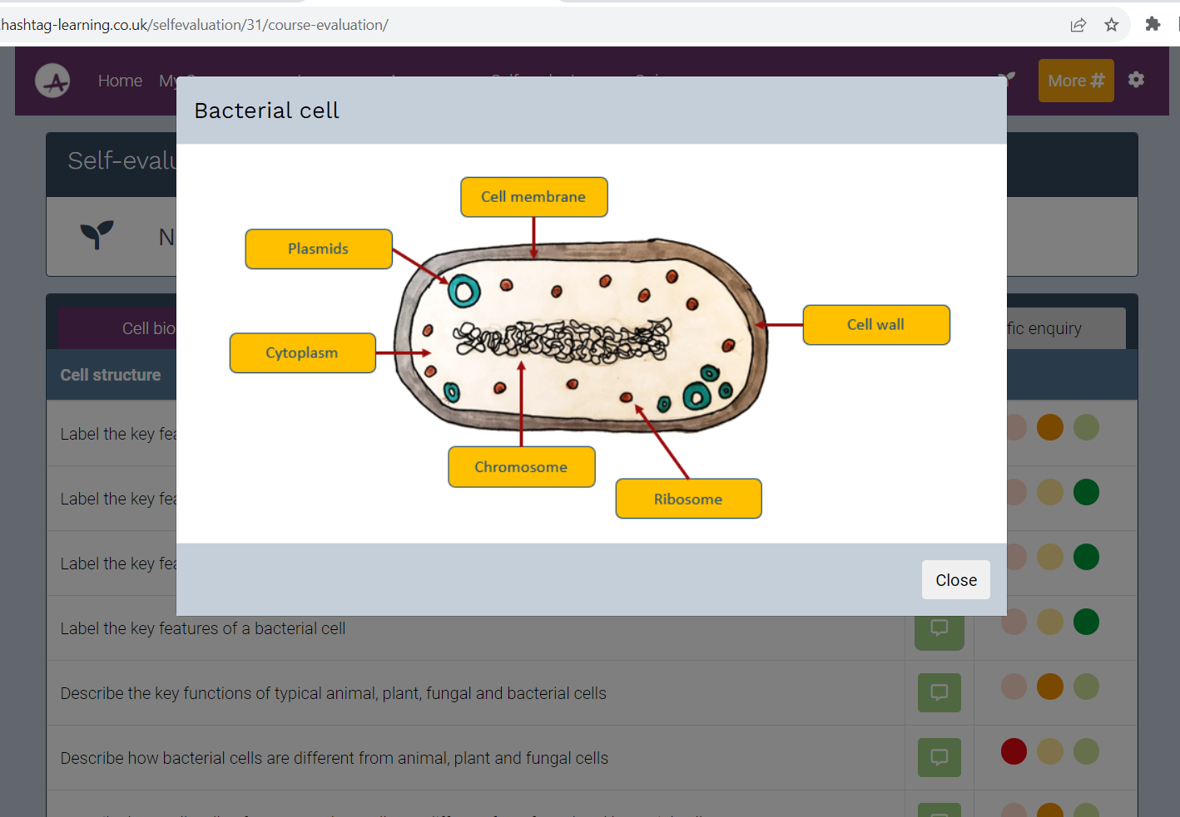
Achieve
Self-evaluate
Notes:
Self-Evaluate: Using Self-evaluate – ACHIEVE (letsachieve.co.uk)
Pupils can record their confidence against each concept in a course in order to build up an overview of strengths and weaknesses by Unit and by Topics. Class teachers can access this info for individual pupils and whole classes and use it as a tool to help identify areas where additional support or teaching may be required.

Slide 14
STUDY SUPPORT
2023-24
51 live online webinars each week, covering 26 subjects,
ranging across levels from N4 through to N5, Higher and AH.
To view the full Study Support timetable and find out how to register, scan the QR code below or visit
www.e-sgoil.com/study-support/
Notes:
e-Sgoil is a national e-learning service established in 2016 in the Western Isles of Scotland. Our focus is on live, interactive, online learning using technology to remove barriers and improve outcomes for young people. e-Sgoil (which stands for e-School in Gaelic) has equity at its heart and seeks to support schools to offer a wide-ranging and resilient curricular offer in response to learner needs.
e-Sgoil was initially concentrated on supporting schools facing acute staffing shortages by providing subject specialist supply from our online teacher bank. Whilst this is still a key part of our work, recent years have seen e-Sgoil deliver the live elements of the National e-Learning Offer (NeLO). This has resulted in a wide-ranging suite of programmes designed to complement the work of schools and support learners at all levels. These programmes are available to schools at no cost and include Study Support, DYW Live, Gaelic Enrichment, Dug’s Discovery Den, Scotland’s Assembly and our provision for interrupted learners i-Sgoil.

Slide 16
E-sgoil

Slide 18
Notes:
Exam Mindset Guide
We’ve partnered with the experts at HeadStrong to produce a video series that will help learners ‘keep the heid’ all the way through the exam process, from study, to prelims and all the way to success in your exams.
There is parent/carer area in the Exam Mindset section of the website which will give you access to excellent resources to give you some useful hints, tips and insights.

Slide 19
Exam Mindset Guide
Notes:
Exam Mindset Guide
We’ve partnered with the experts at HeadStrong to produce a video series that will help learners ‘keep the heid’ all the way through the exam process, from study, to prelims and all the way to success in your exams.
There is parent/carer area in the

Slide 20
Scholar
Notes:
Scholar offers 42 online courses for Scottish schools and colleges aligned to the SQA curriculum at National 5, Higher and Advanced Higher level.
Scholar can be accessed through the Scholar Tile on Glow

Slide 21
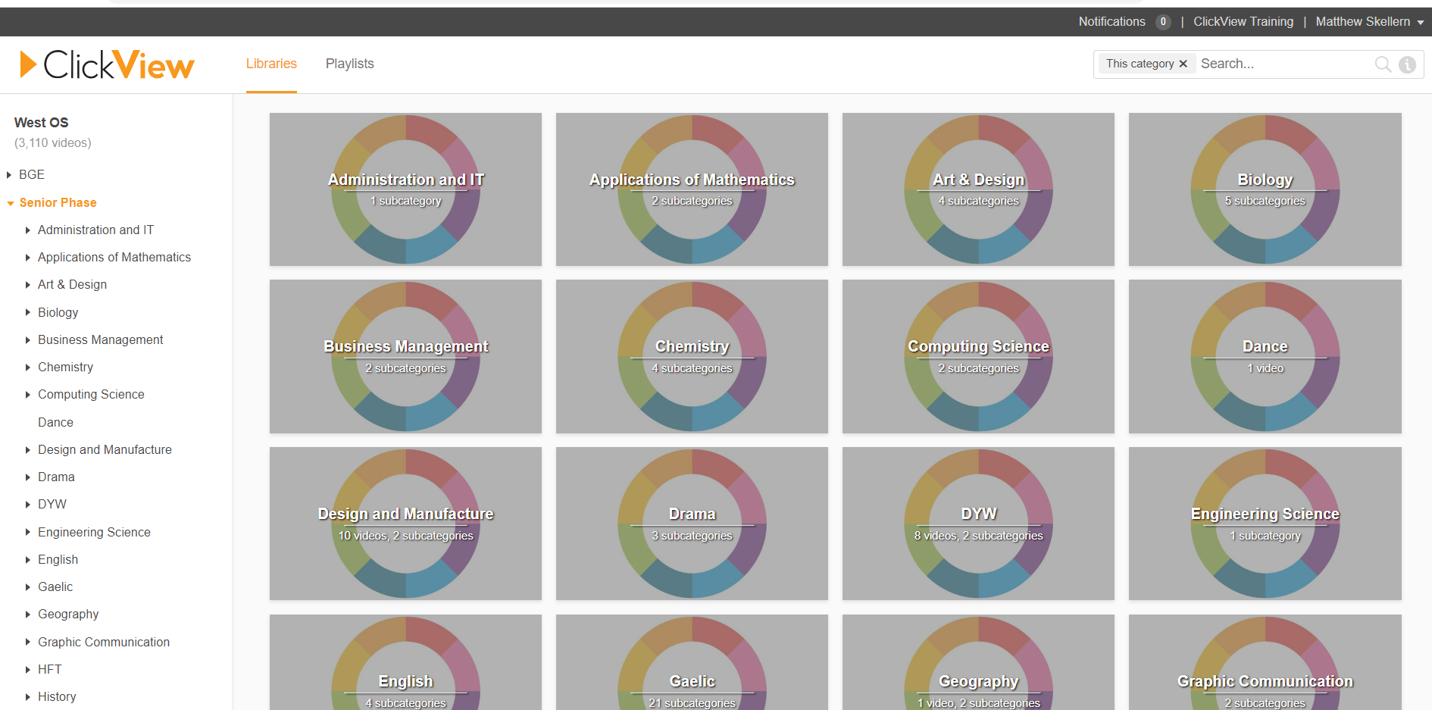
West Os

Slide 22
Specific subject resources

